Slide 1

Fingerprint safe
Group 1
Sub-group 6
SHUBHENDU PANDEY
ASHWANI KUMAR KAMAL
KARTIK PONTULA
SAILADA VISHNU VARDHAN

Slide 2
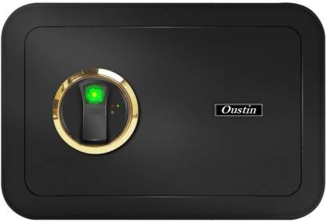
PROJECT IDEA
Safe-keeping box that, instead of requiring a traditional key to open, uses fingerprint recognition.
Significantly harder to break into, since lockpicking is rendered useless and a fingerprint is much harder to duplicate.
This project is a prototype of what could be a commercially distributed fingerprint safe.

Slide 3
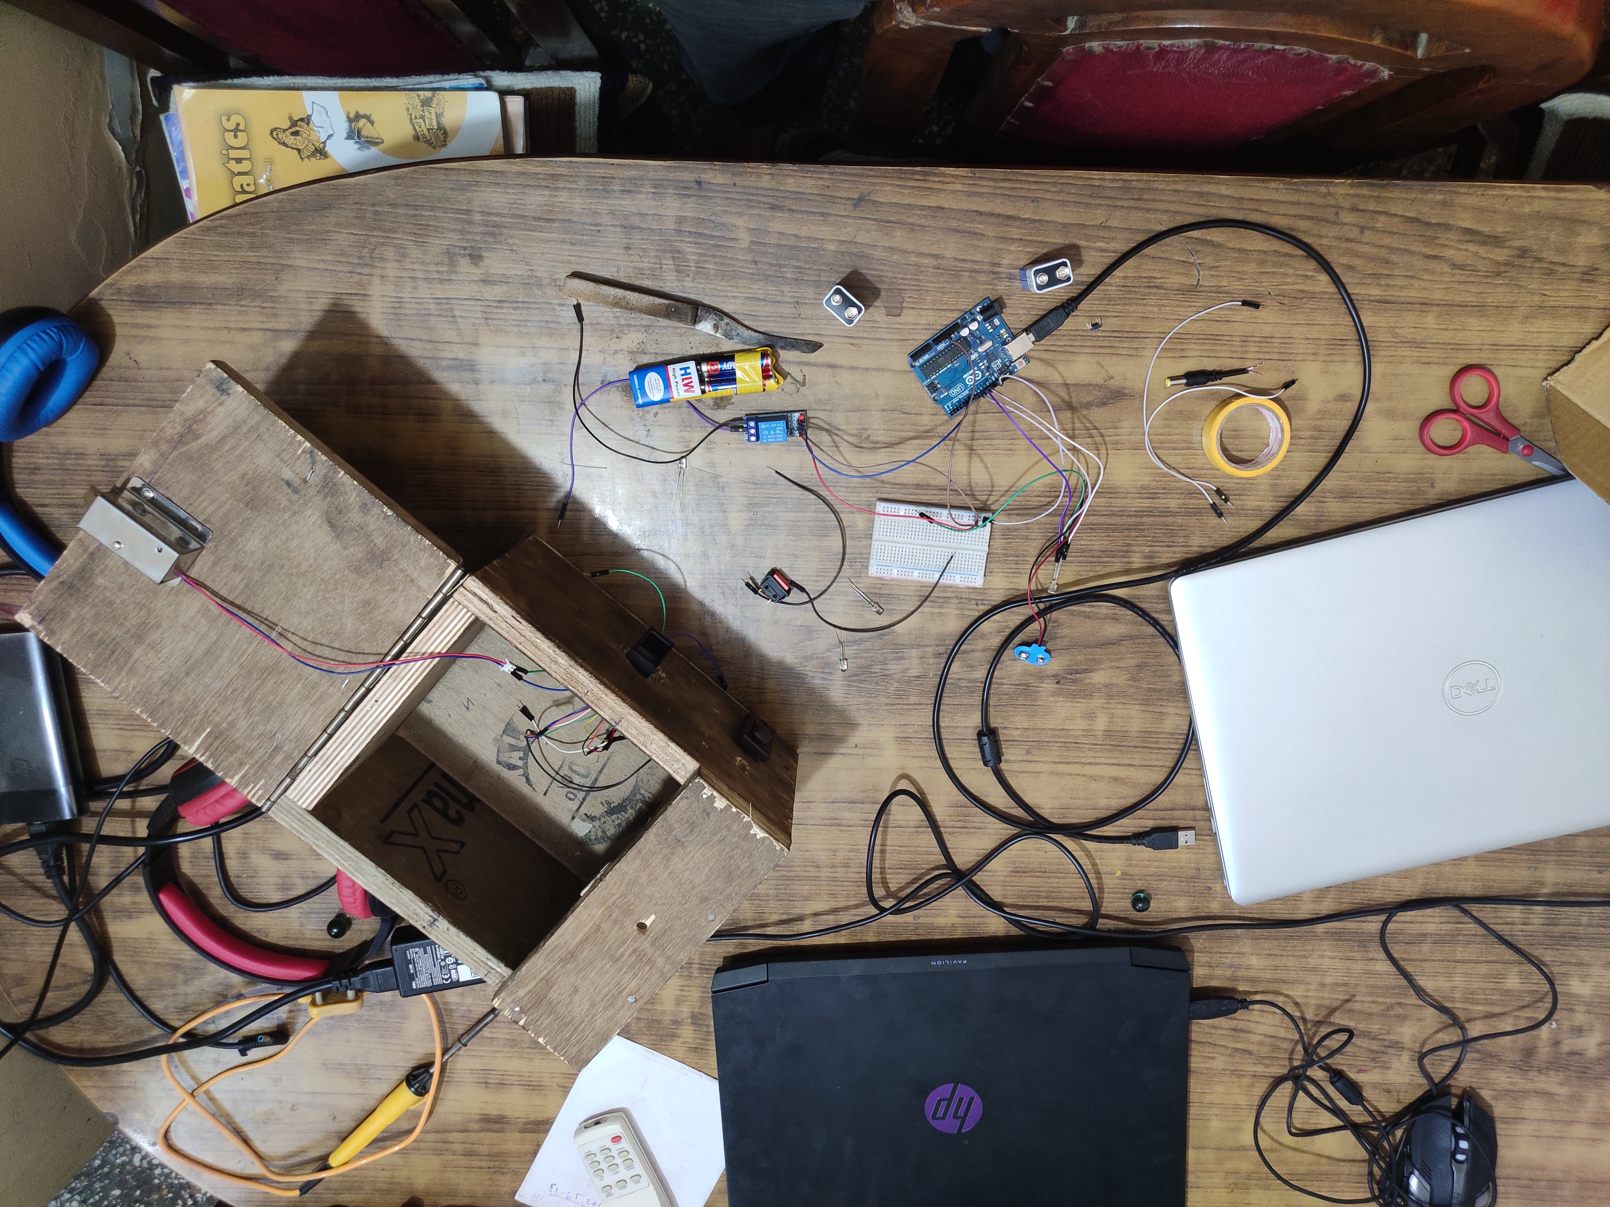
DESCRIPTION
A wooden box with a hinged lid, a fingerprint sensor, an RGB LEB bulb, a power on/off switch, and a pushbutton visible on the outside.
Circuit would be housed inside the box, separate from the space for the belongings to be stored.
The safe would have 3 states of operation:
Neutral, Enrollment, Deletion

Slide 4
OUR APPROACH
The first and foremost goal was to get a concrete picture of the physical construction of the box, which was to be made by a carpenter.
Time was spent brainstorming on developing the CAD model of the safe with precise dimensions.
The final STL files of the box models, and some screenshots with dimensioning can be found in the report.

Slide 5
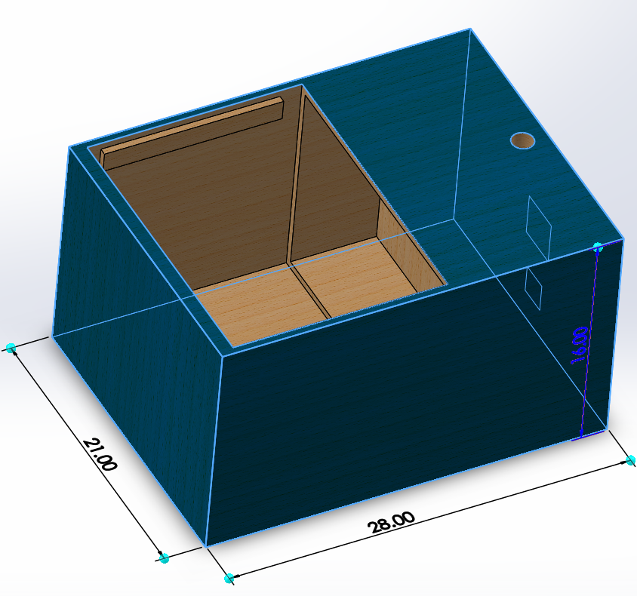
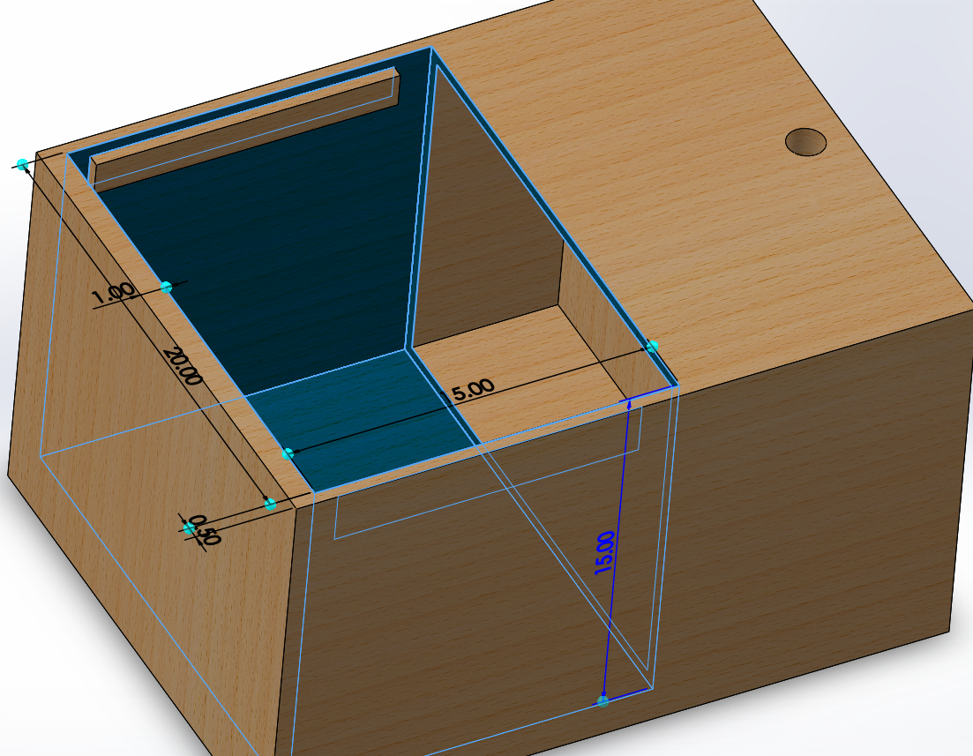
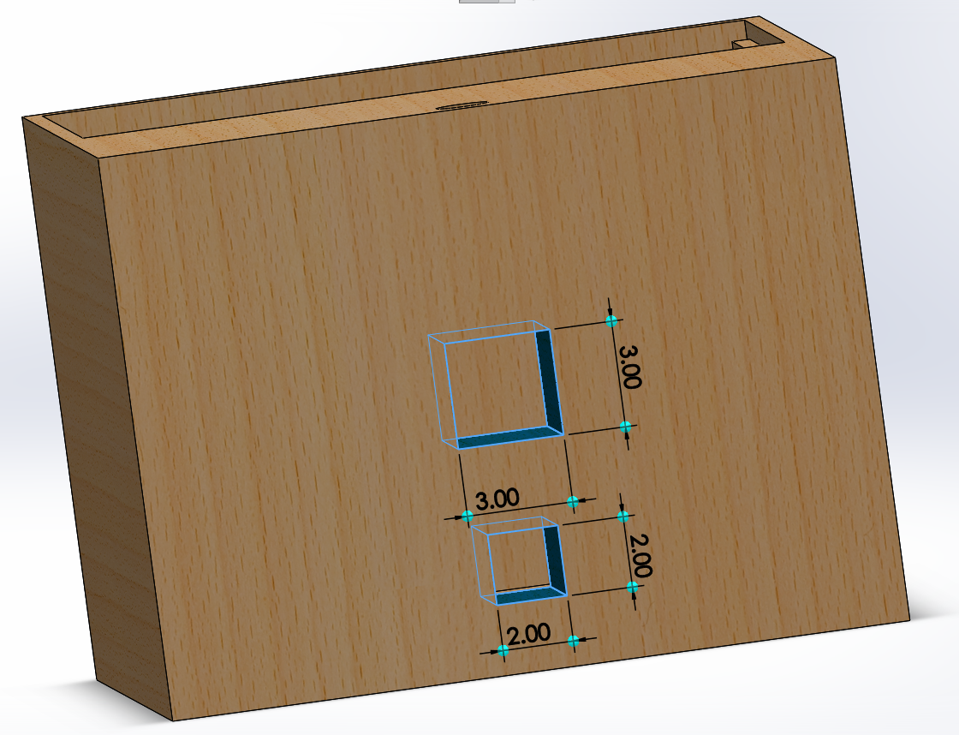
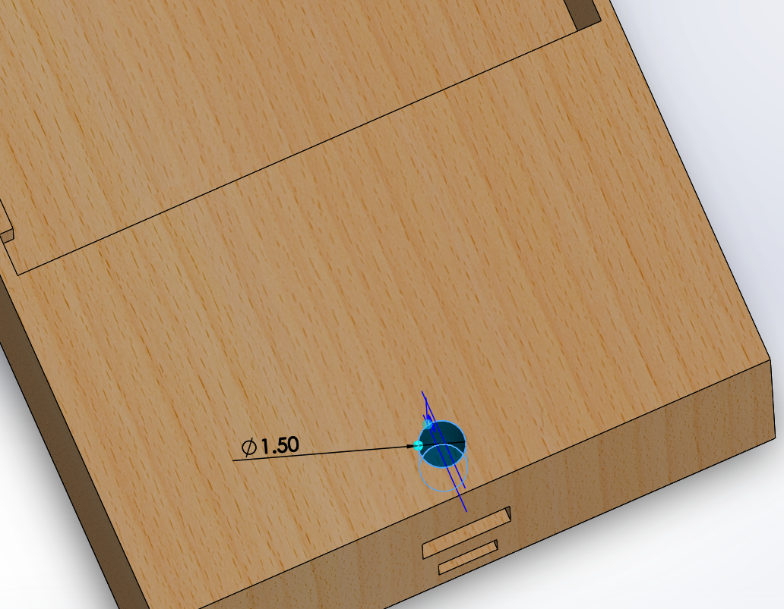

Slide 6
THE COMPONENTS
The components decided to be used were:
Arduino Uno R3
AS608 fingerprint sensor module (12 V)
Wooden box, with hinges and a handle
Solenoid Lock
Relay module (for the solenoid lock) (5 V)
RGB LED
Pushbutton and switch
12 V DC power supply
Jumper cables

Slide 7

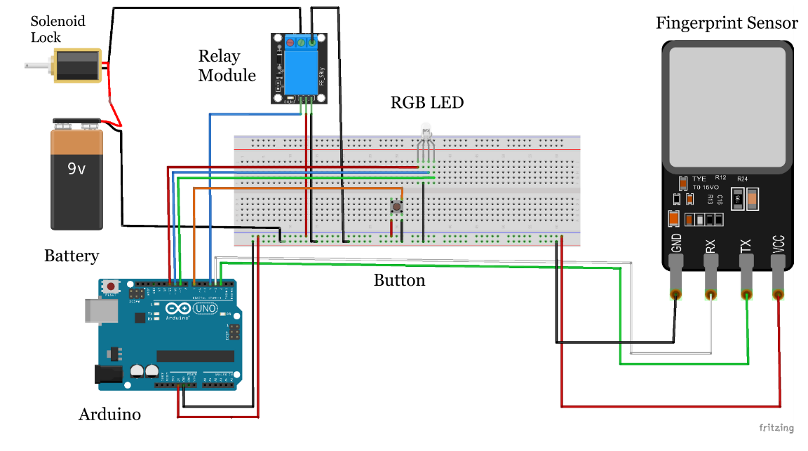

THE CIRCUIT

Slide 8
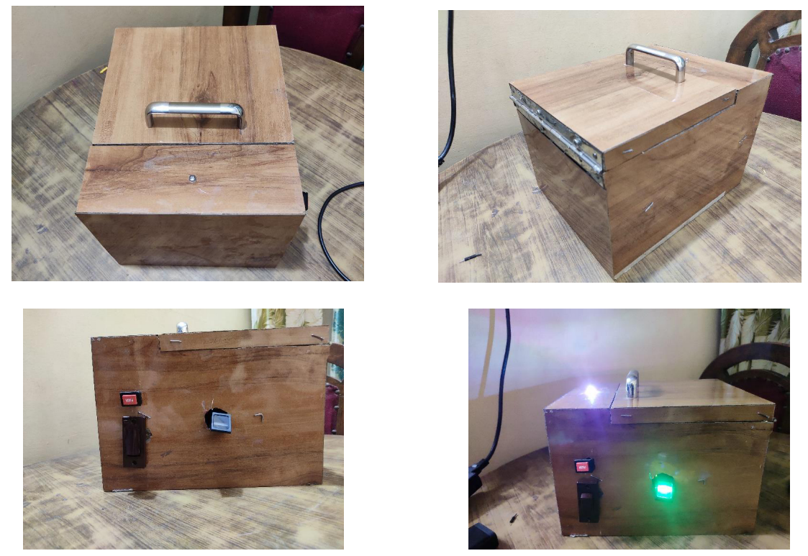
The box

Slide 9

THE CODE
A sample testing code was used for the setup initially, to detect faults in hardware if any.
The last week was spent on writing the final Arduino code, which can be found in the report.
Note: The statements involving Serial are used for bug testing. They are to be commented out for regular operation of the safe without a USB connection.
getFingerprintIDez() : checks the input fingerprint
getFingerprintEnroll() : enrolls new fingerprint
finger.emptyDatabase() : clears all saved fingerprints
holdTime : measured value of button holdtime using millis() function

Slide 10

WORK DISTRIBUTION
SHUBHENDU PANDEY
• Made the CAD models and played a major role in design work • Used ANSYS to test the strength of the box • Contributed to the code
ASHWANI KUMAR KAMAL
• Acquired all hardware necessary and assembled the project • Designed the circuit • Played major role in code improvement and bug testing • Participated in box design
KARTIK PONTULA
• Played major role in code improvement and bug testing • Played a role in CAD modelling and participated in box design • Created weekly reports and edited the presentation video
SAILADA VISHNU VARDHAN
• Created the basic structure of the final code • Participated in box design

Slide 11
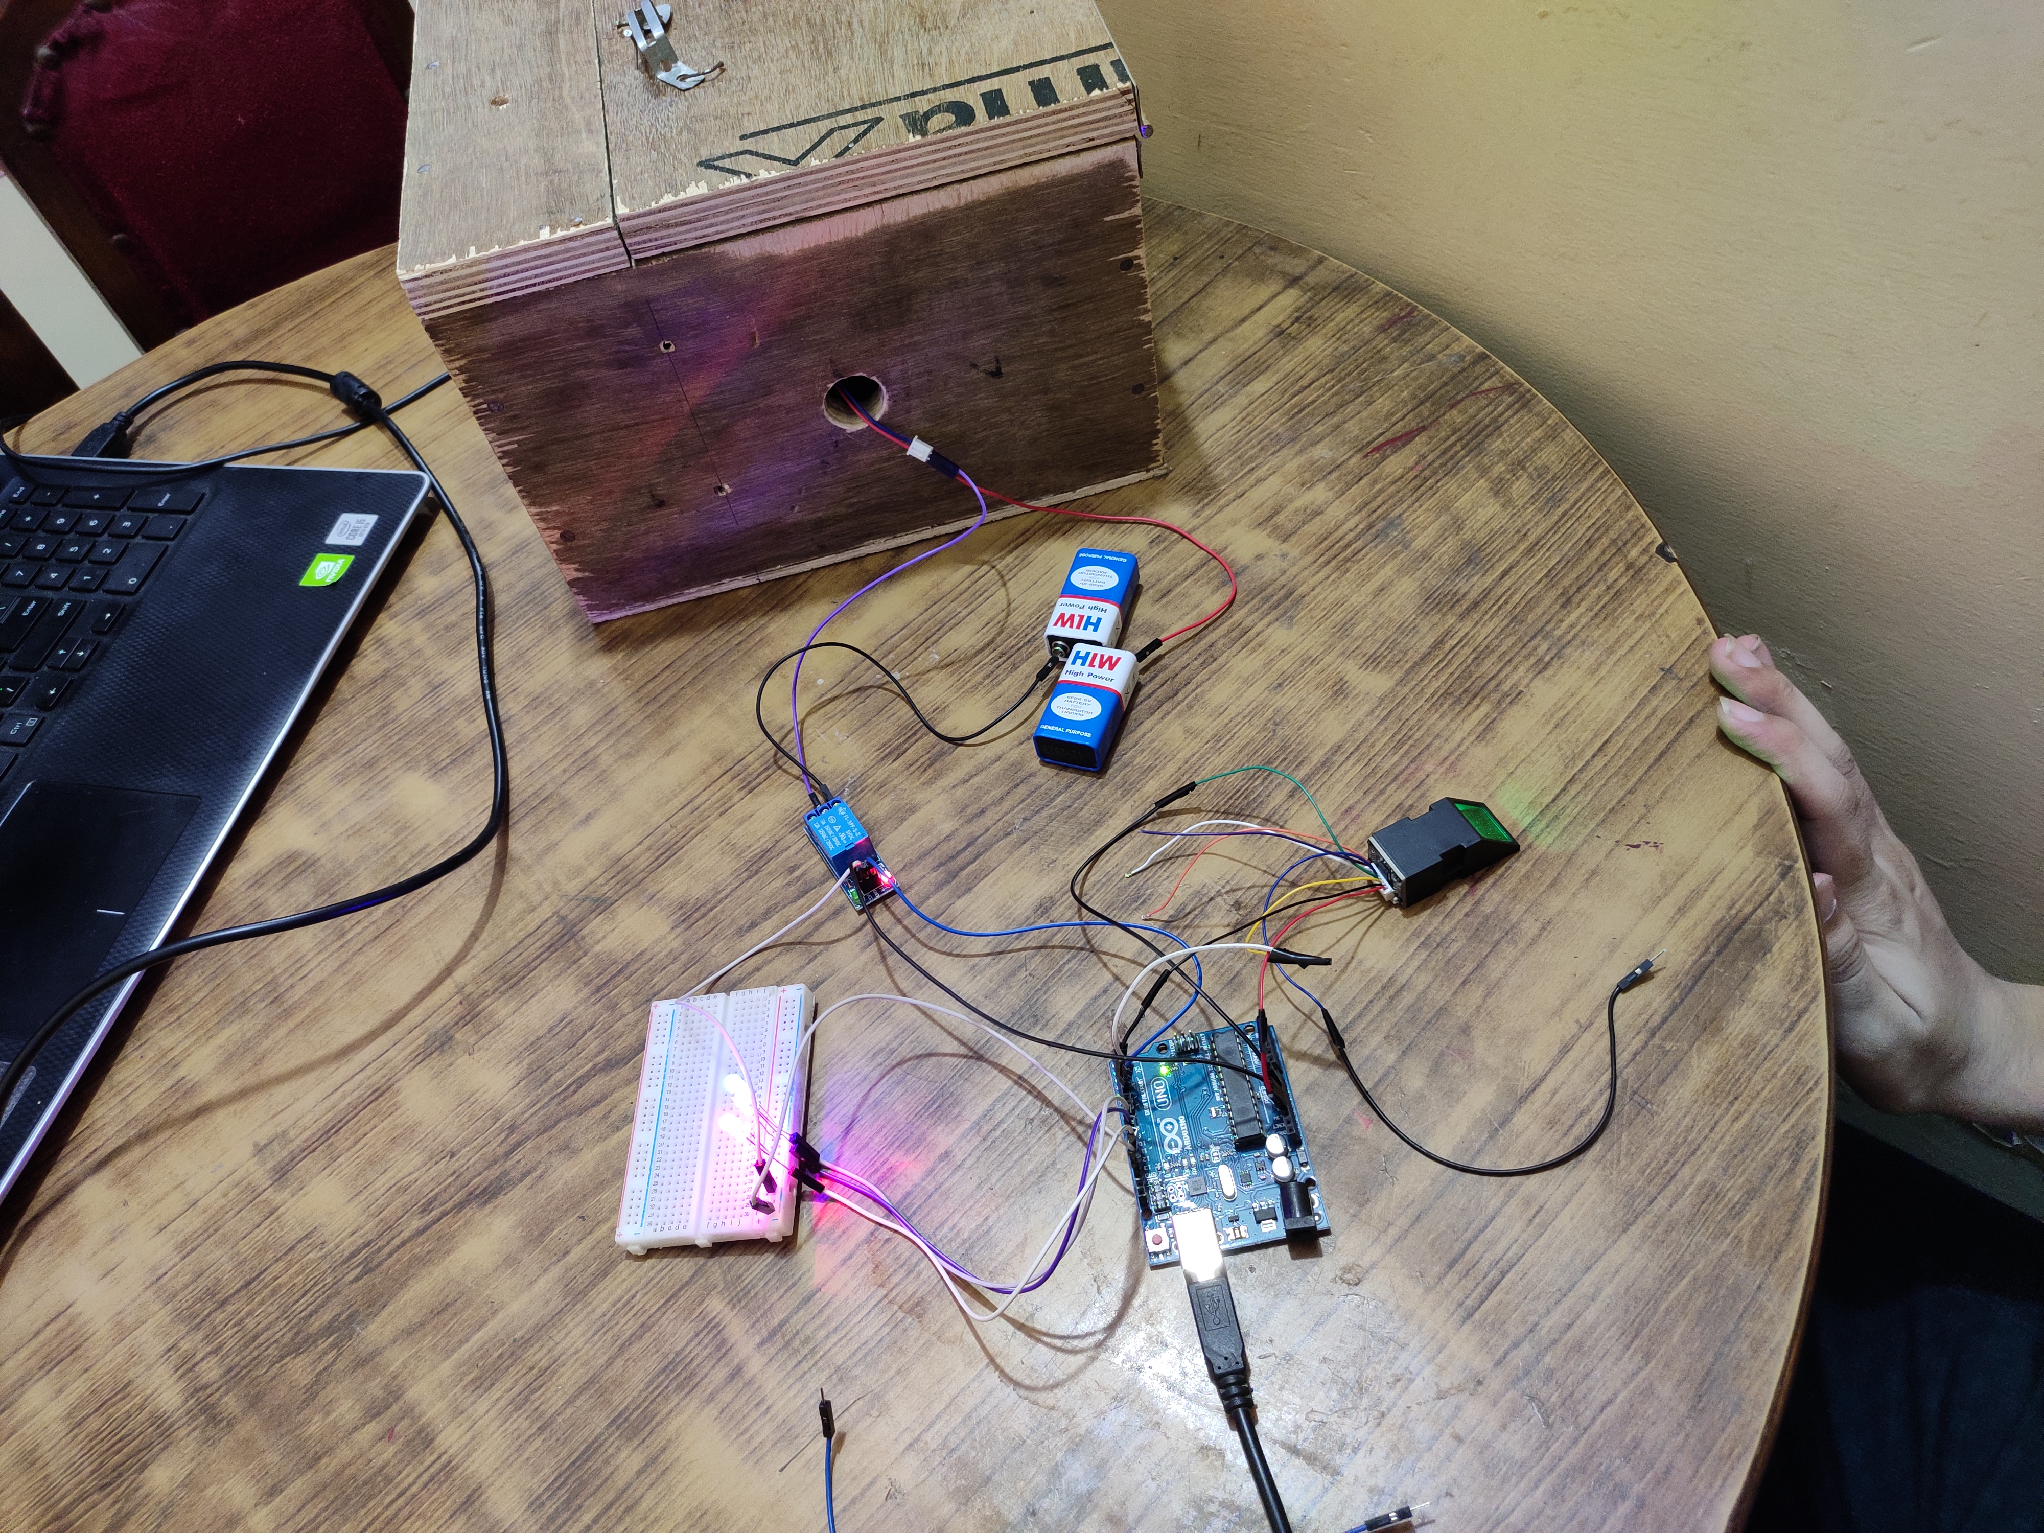
ISSUES ENCOUNTERED
Miscommunication with the carpenter
Inaccuracy in time measured
Red blinking
Arduino undetected by PC
Hinges are on the outside
What if the circuit fails?

Slide 12
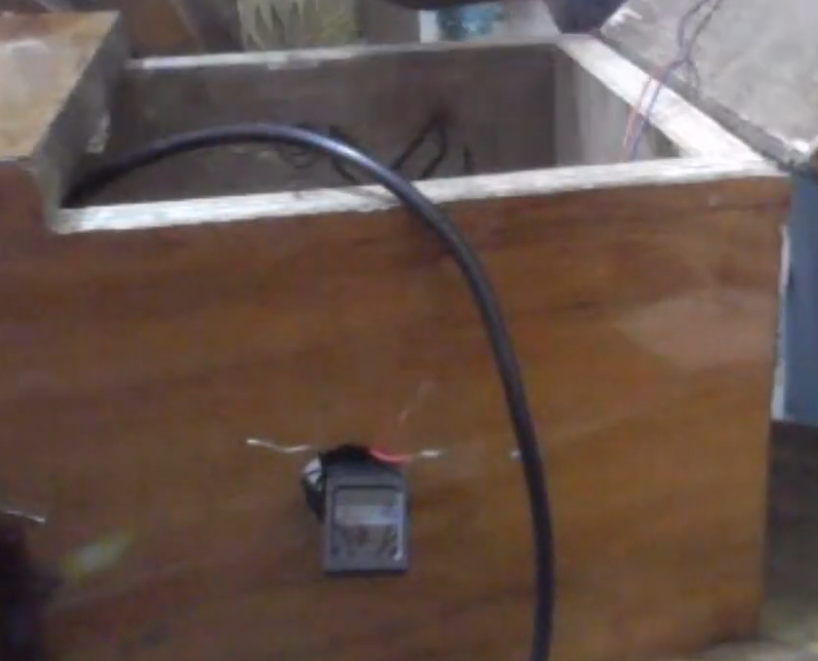

Slide 13
ROUGH TOTAL COST
Fingerprint Sensor – Rs. 1000
Solenoid Lock – Rs. 500
Wooden Box ~ Rs. 1000
Arduino and other electronic parts ~ Rs. 400
TOTAL ~ Rs. 3000

Slide 14
CONCLUSION
The fingerprint sensor has been successfully implemented (albeit with minor flaws) and shows the desired behavior.

Slide 15
THANK YOU!!

